Slide 1
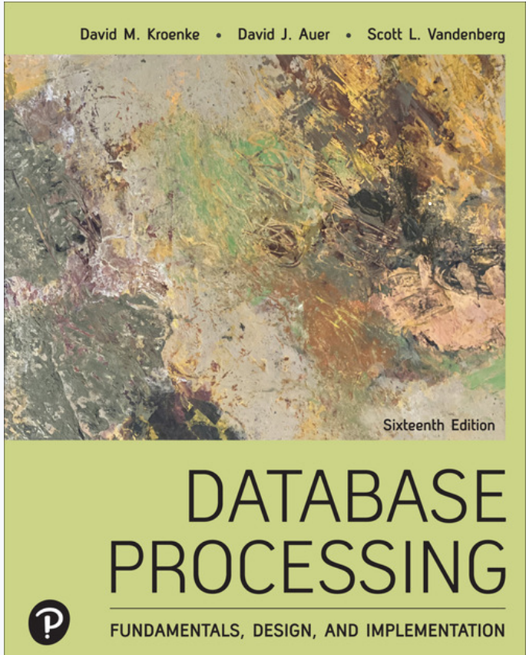
Database Processing: Fundamentals, Design, and Implementation
16th Edition
Chapter 3
Logical Design:
Relational Model

Slide 2
Learning Objectives
Understand basic relational data model terminology
Understand characteristics of relations
Also called “tables”
Identify primary, candidate, and composite keys
Hint: These will come from the entities in the conceptual model
Identify possible insertion, deletion, and update anomalies in a relation
Basic commands
Learn how to transform a conceptual model into a logical model
Entity-relationship model to relational model
Next

Slide 3
Database Design and Implementation
Requirements
Collection & Analysis
Requirement collection methods
E.g., Highline University
Requirement specifications
Conceptual
Design
Data modeling methods e.g. E-R Modeling
Conceptual models
Logical
Design
Database Systems (Relational Databases)
Logical models &
Performance requests
Physical
Design
DBMS (Oracle, SQLServer, MySQL,…)
Database Schema
Application
Design
Application development methods
Database Applications
Constructs:
Conceptual design – entities, relationships, attributes, min/max cardinalities [High level of abstraction]
Relational design -- relations (1 construct)

Slide 4

Recall from Session 1: How we described a database.
A database is a set of data that has a regular structure and is organized in such a way that a computer can easily retrieve the desired results.
Structure – structure of relational data model dictates how data stored in the database implementation. Well-known characteristics of relational databases enables database developers to create databases with needed, proper structure.
Organized -- rules for transforming a conceptual model into a relational model with appropriate structure

Slide 5
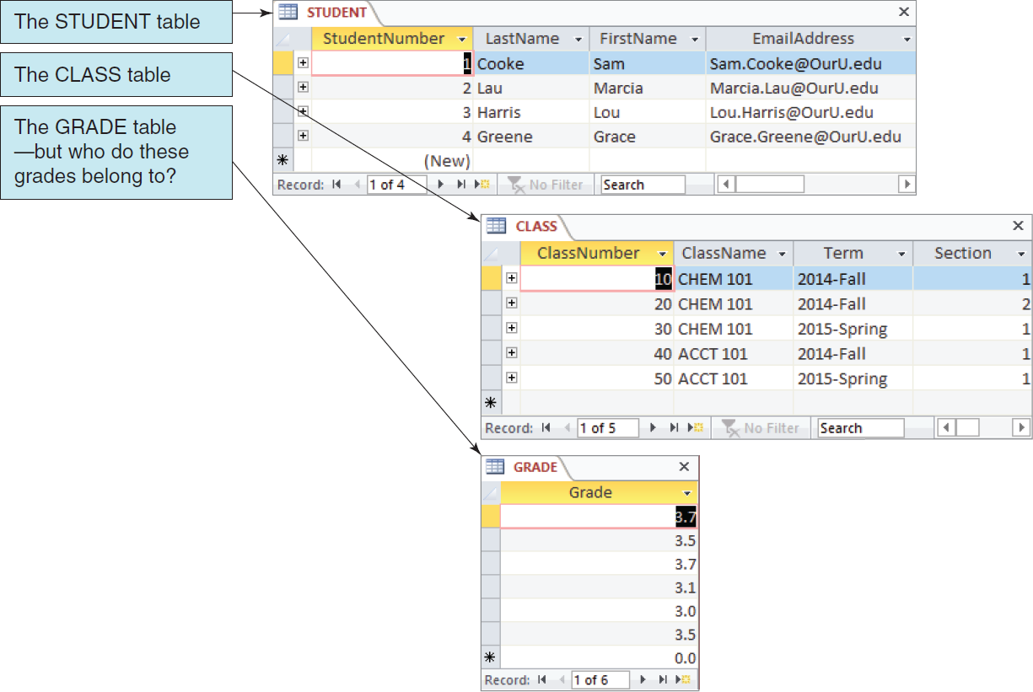
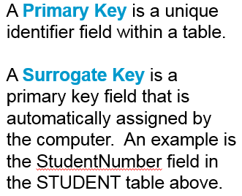
Data in Tables (Relational Model)
What was problematic with this example?
(from Session 1: The Nature of Data)
Recall:
Course: focuses on how to design good databases
Notes:
Note: Harold Wise of East Carolina University contributed material for this slide.

Slide 6
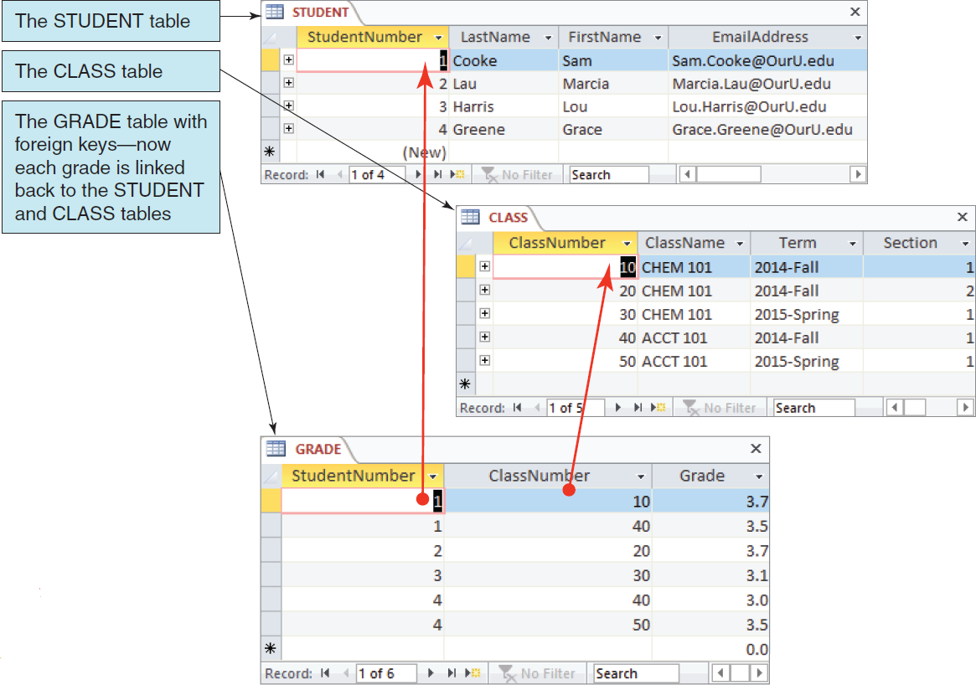
Characteristic of Databases: Related Relations (Tables) Challenge: proper and efficient design
Why is this better?
Notes:
Note: Harold Wise of East Carolina University contributed material for this slide.

Slide 7
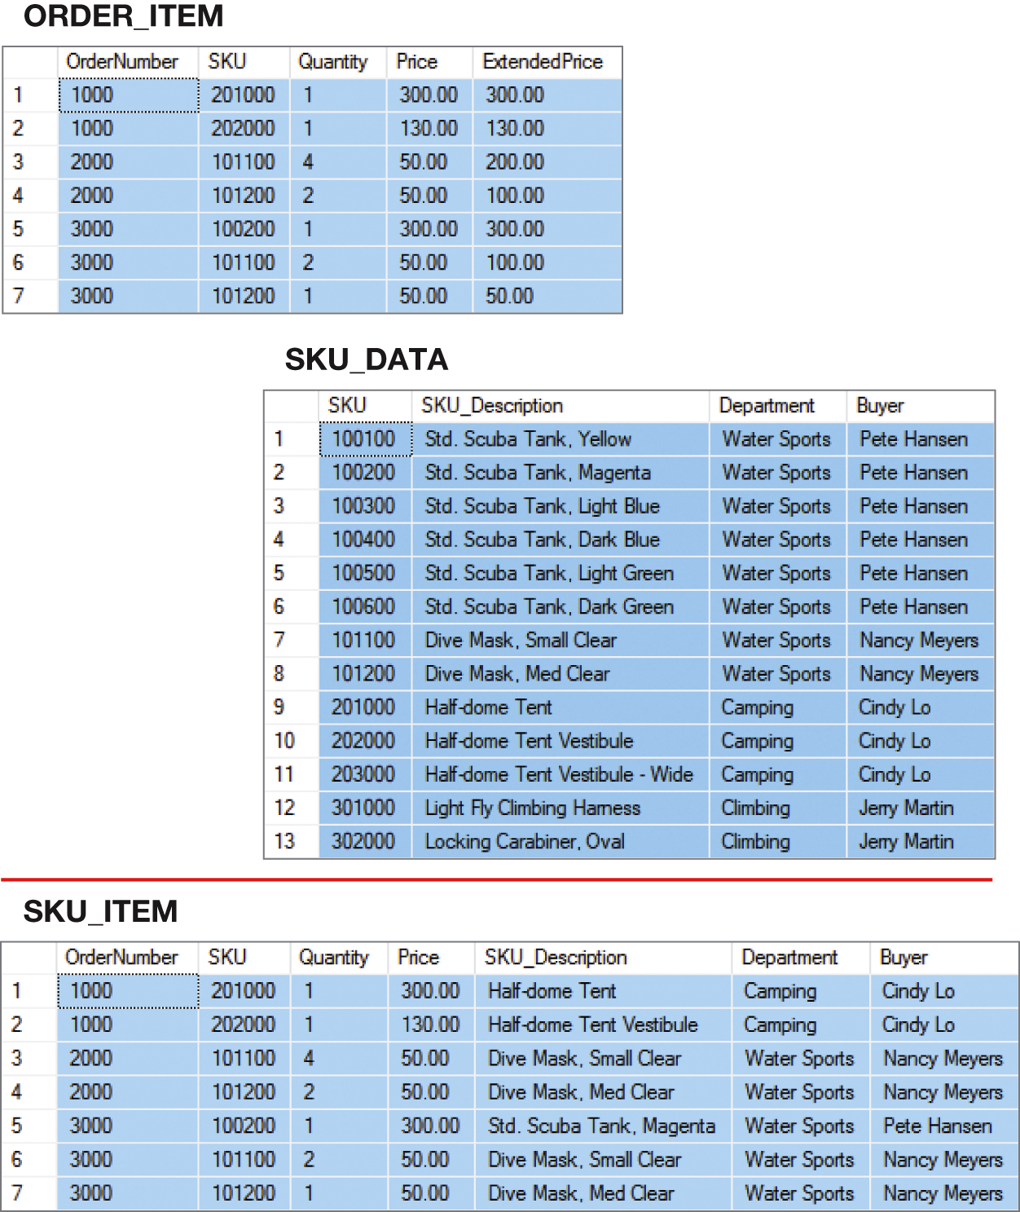
Figure 3-1: How Many Tables?
Answer: The number of tables (relations) is based on the (well-designed) conceptual model.

Slide 8
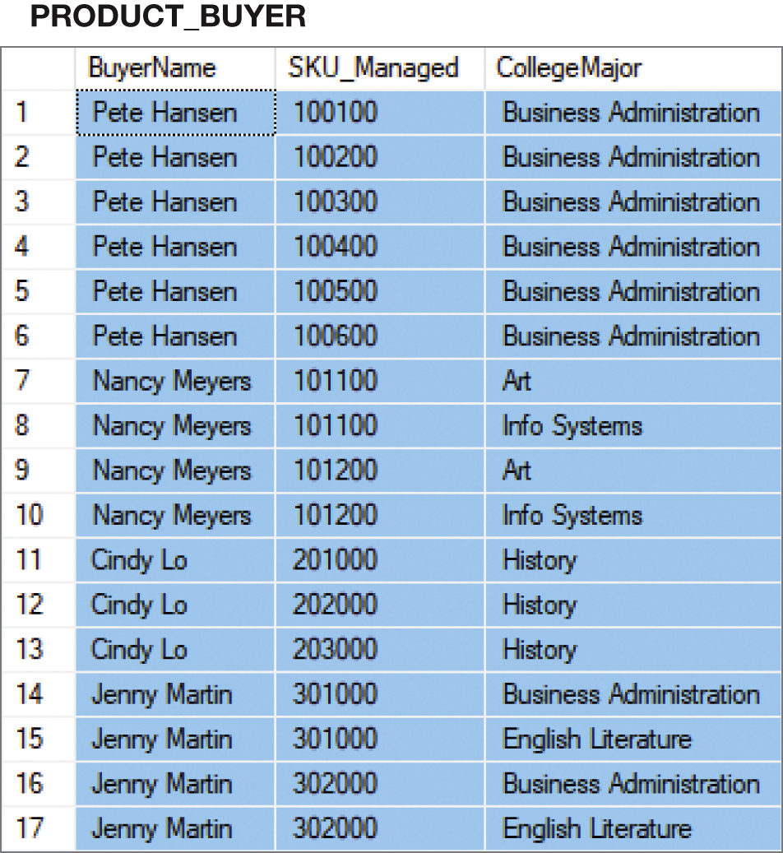
Figure 3-2: A Very Strange Table!
To understand why this is a very odd table, suppose that Nancy Meyers is assigned a new, SKU 101300. What addition should we make to this table? One or two rows?

Slide 9
But First--
We need to understand:
Structure of relational model
Terminology related to relational model

Slide 10
A little history: Relational Model
Created by Engineer, E.F. Codd, 1970
Used mathematics
Standard model for commercial DBMS products
“Stood the test of time”
Why? based on mathematics: “relational algebra”

Slide 11
Figure 3-3 Important Relational Model Terms
Important Relational Terms
Relation
Functional Dependency
Determinant
Candidate Key
Composite Key
Primary Key
Surrogate Key
Foreign Key
Referential integrity constraint
Normal forms
Multivalued dependency

Slide 12
Figure 3-4: Characteristics of Relations
Relational DBMS products store data about entities in relations, which are a special type of table.
A relation is a two-dimensional table that has the following characteristics:
Characteristics of Relations
Rows contain data about an entity.
Columns contain data about attributes of the entities.
All entries in a column are of the same kind.
Each column has a unique name.
Cells of the table hold a single value.
The order of the columns is unimportant.
The order of the rows is unimportant.
No two rows may be identical.
Learn these
characteristics!

Slide 13
Important concept
Domain Integrity Constraint
Requirement that all of the values in a column are of the same kind
Domain
grouping of data that meets a specific type definition.
FirstName could have a domain of names such as Albert, Bruce, Cathy, David, Edith, etc.
All values of FirstName must come from the names in that domain.
Columns in different relations
May have the same name.
Example?
Note: Understanding the domain is part of the work needed to structure a good relational database. Different than semantics of “application domain.”

Slide 14
Figure 3-5: Sample EMPLOYEE Relation
EmployeeNumber | FirstName | LastName | Department | EmailAddress | Phone
100 | Jerry | Johnson | Accounting | JJ@somewhere.com | 518-834-1101
200 | Mary | Abernathy | Finance | MA@somewhere.com | 518-834-2101
300 | Liz | Smathers | Finance | LS@somewhere.com | 518-834-2102
400 | Tom | Caruthers | Accounting | TC@somewhere.com | 518-834-1102
500 | Tom | Jackson | Production | TJ@somewhere.com | 518-834-4101
600 | Eleanore | Caldera | Legal | EC@somewhere.com | 518-834-3101
700 | Richard | Bandalone | Legal | RB@somewhere.com | 518-834-3102
Note: An employee relation comes from an employee entity in a conceptual model.
The employee relational “represents” the employee entity.

Slide 15
Figure 3-6 Tables That are Not Relations: Multiple Entries per Cell
EmployeeNumber | FirstName | LastName | Department | EmailAddress | Phone
100 | Jerry | Johnson | Accounting | JJ@somewhere.com | 518-834-1101
200 | Mary | Abernathy | Finance | MA@somewhere.com | 518-834-2101
300 | Liz | Smathers | Finance | LS@somewhere.com | 518-834-2102
400 | Tom | Caruthers | Accounting | TC@somewhere.com Fax: Home: | 518-834-2102 518-834-9911 518-723-8795
500 | Tom | Jackson | Production | TJ@somewhere.com | 518-834-4101
600 | Eleanore | Caldera | Legal | EC@somewhere.com Fax: Home: | 518-834-3101 518-834-9912 518-723-7654
700 | Richard | Bandalone | Legal | RB@somewhere.com | 518-834-3102
Question: Why might this be a problem when we want a database that has structure?

Slide 16
Figure 3-7 Tables That Are Not Relations: Table with Required Row Order
EmployeeNumber | FirstName | LastName | Department | EmailAddress | Phone
100 | Jerry | Johnson | Accounting | JJ@somewhere.com | 518-834-1101
200 | Mary | Abernathy | Finance | MA@somewhere.com | 518-834-2101
300 | Liz | Smathers | Finance | LS@somewhere.com | 518-834-2102
400 | Tom | Caruthers | Accounting | TC@somewhere.com | 518-834-2102
 |  |  |  | Fax: | 518-834-9911
 |  |  |  | Home: | 518-723-8795
500 | Tom | Jackson | Production | TJ@somewhere.com | 518-834-4101
600 | Eleanore | Caldera | Legal | EC@somewhere.com | 518-834-3101
 |  |  |  | Fax: | 518-834-9912
 |  |  |  | Home: | 518-723-7654
700 | Richard | Bandalone | Legal | RB@somewhere.com | 518-834-3102
Question: What is the “required row order” here?

Slide 17
Figure 3-8 A Relation with Values of Varying Length
EmployeeNumber | FirstName | LastName | Department | EmailAddress | Phone | Comment
100 | Jerry | Johnson | Accounting | JJ@somewhere.com | 518-834-1101 | Joined the Accounting Department in March after completing his MBA. Will take the CPA exam this fall.
200 | Mary | Abernathy | Finance | MA@somewhere.com | 518-834-2101
300 | Liz | Smathers | Finance | LS@somewhere.com | 518-834-2102
400 | Tom | Caruthers | Accounting | TC@somewhere.com | 518-834-1102
500 | Tom | Jackson | Production | TJ@somewhere.com | 518-834-4101
600 | Eleanore | Caldera | Legal | EC@somewhere.com | 518-834-3101
700 | Richard | Bandalone | Legal | RB@somewhere.com | 518-834-3102 | Is a full-time consultant to Legal on a retainer basis.
Question: Is the comment column valid? Why or why not?

Slide 18
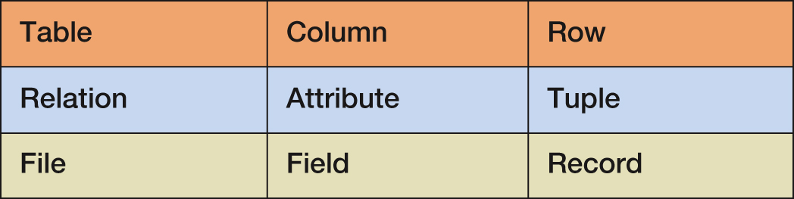
Figure 3-9 Alternative Terminology
Although not all tables are relations, the terms table and relation are often used interchangeably (unfortunately).
The following sets of terms are equivalent:
This course: First two rows.

Slide 19

Keys [Revisited, as entities]
A key is a combination of one or more columns that is used to identify particular rows in a relation.
A composite key is a key that consists of two or more columns.
tdwi.org

Slide 20
The Entity (Relation) Integrity Constraint
Entity integrity constraint -- the primary key must have unique data values inserted into every row of a table.
The phrase unique data values implies that this column is NOT NULL, and does not allow a NULL value in any row.
Note: The concept of a null value is important. Will revisit.

Slide 21
Foreign Keys (1 of 2)
Foreign key -- column or composite of columns that is the primary key of a table other than the one in which it appears.
Key of table -- foreign to the one in which it appears as the primary key.
Foreign key – concept for relations
*Understand how/why

Slide 22

Foreign Keys (2 of 2)
Text: The primary keys of the relations are underlined and any foreign keys are in italics in text. (Italics not required for course work).
DEPARTMENT (DepartmentName, BudgetCode, ManagerName)
EMPLOYEE (EmployeeNumber, EmployeeLastName,
EmployeeFirstName, DepartmentName)
Interpretation

Slide 23
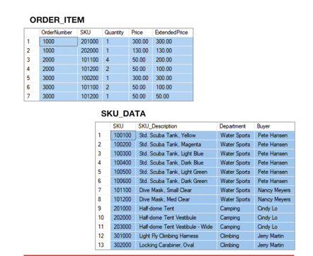
Referential Integrity Constraint
Referential integrity constraint: statement that limits values of the foreign key to those already existing as primary key values in corresponding relation:
SKU in ORDER_ITEM must exist in SKU in SKU_DATA

Slide 24
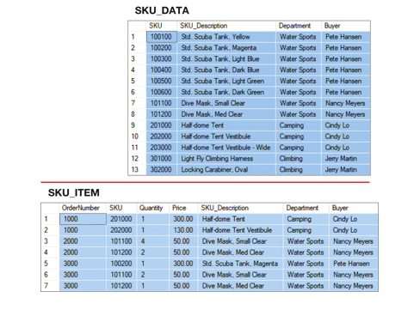
Foreign Key with Referential Integrity Constraint
SKU_DATA (SKU, SKU_Description, Department, Buyer)
ORDER_ITEM (OrderNumber, SKU, Quantity, Price, ExtendedPrice)
Where ORDER_ITEM.SKU must exist in SKU_DATA.SKU
Underline primary key

Slide 25
Database Integrity (Important)
Three constraints:
domain integrity constraint
entity integrity constraint
referential integrity constraint
As a whole:
database integrity
data in a database will be useful, meaningful data

Slide 26
Normalization
“Rules” for well-formed relations.
Depends on well-formed conceptual models.
Later
1NF 2NF 3NF 4NF 5NF

Slide 27
Transform Conceptual Model to Logical Model
Requirements
Collection & Analysis
Requirement collection methods
Requirement specifications
Last time
Conceptual
Design
Data modeling methods e.g. E-R Modeling
Conceptual models
Today
Logical
Design
Database Systems (Relational Databases)
2 rules
Logical models &
Performance requests
Physical
Design
DBMS (Oracle, SQLServer, MySQL,…)
Database Schema
Application
Design
Application development methods
Database Applications

Slide 28
Transformation to Logical Model
Two rules: transform conceptual model (entity-relationship model) to a logical model (relational model).
Called: Transformation / conversion / mapping rules. [Important and will be revisited.]
Rule 1: Each entity becomes a relation (table) with same key
Rule 2: Each relationship represented by foreign key or separate relation. Depends on min/max cardinalities of relationship.
1:N – Represented by foreign key
(0,1) and (0/1,N) – foreign key (can have null value)
(1,1) and (0/1,N) – foreign key (cannot have null value)
N:M – Represented by creating separate relation
(0/1,N) and (0/1,M)
Key is concatenation (joining together) of keys of the two entities
Relationship attributes become non-keys
1:1 – foreign key
(1,1) and (1,1) – foreign key in either relation (decide based upon usage)
(0,1) and (1,1) [or (1,1) and (0,1)] – use foreign key such that null values not allowed.

Slide 29
Conclusion
Introduction to relational data model
Important terminology
Translation rules for conceptual to logical models
Conceptual model is important
Abstracts and represents the application domain
Follows the rules for creating conceptual model

